Slide 1
SIMPLE SCENARIO bootstrapping
OCTOBER 2026

Slide 2
Ways of generating scenarios
To recap: there are several ways of generating scenarios, which include:
  Using history
  Monte Carlo simulation
  Boot-strapping
Boot-strapping is a way of taking short periods from history and combining them to generate lots of scenarios of longer length.
It takes a small number of historical periods and can generate many times more simulated scenarios.

Slide 3
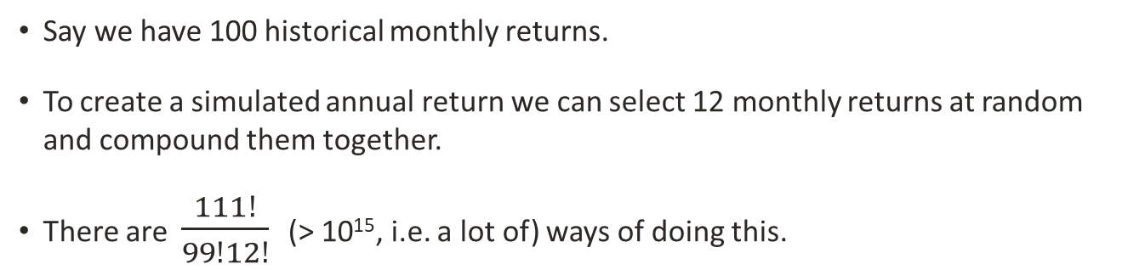
How it works
Say we have 100 historical monthly returns.
To create a simulated annual return we can select 12 monthly returns at random and compound them together.
There are $\frac{111!}{99!12!}$ (> 10¹⁵, i.e. a lot of) ways of doing this.
So even if we generate 1,000 years’ worth of scenarios, they will still be practically independent of each other.
Which means we get rid of serial correlation – any tendency for one scenario to influence the next.
But because we are using the same months for each asset we are preserving the correlations between their returns.

